Slide 1


AUTOMATED BONE FRACTURE DETECTION IN X-RAY IMAGES USING DIGITAL IMAGE PROCESSING
Presented by:
Aswath Siddharth R
Kavin Karthic M

Slide 2

INTRODUCTION
The Problem
Manual diagnosis of bone fractures from X-rays is a critical task.
However, it can be time-consuming and is subject to human error and radiologist fatigue.
The Solution
Develop an automated system using Digital Image Processing (DIP) to provide a faster, objective, and reproducible diagnostic aid.
Our Approach
This work uses a pipeline of classical DIP techniques to enhance, segment, and highlight fracture regions before classification.

Slide 3

Evolution of Techniques:
Traditional DIP:
Used methods like Sobel/Canny edge detection and morphological operations.
Limitation: Struggled with noise, low contrast, and complex fracture cases.
Classical Machine Learning:
Employed classifiers like SVM and Random Forest with handcrafted features (e.g., texture, shape).
Limitation: Required manual feature engineering and had poor generalization.
Deep Learning (CNNs):
Modern models (ResNet, U-Net, YOLO) achieve high accuracy.
Limitation: Require massive labeled datasets and often function as "black boxes," lacking interpretability.

Slide 4

A Hybrid and Interpretable Approach
Our work emphasizes a robust Digital Image Processing pipeline for enhancement and segmentation beforeclassification.
This fusion of classical DIP with a lightweight CNN balances three key aspects:
Accuracy: Achieves high performance in detection.
Explainability: The preprocessing steps provide clear, visual evidence of how the system identifies a fracture.
Efficiency: Less computationally intensive than purely deep learning models.
This makes our system highly suitable as a transparent and reliable support tool in clinical settings.

Slide 5

THE PROCESSING PIPELINE
Our system follows a structured, multi-stage workflow:
Data Acquisition: Utilized the public MURA (Musculoskeletal Radiographs) dataset.
Preprocessing: Images are resized, normalized, and cleaned using Gaussian and median filters to reduce noise.
Contrast Enhancement: Contrast stretching and CLAHE are applied to make faint fracture lines more visible.
Edge Detection: The Canny edge detector precisely highlights discontinuities and boundaries of the bone fracture.
Morphological Operations: Dilation and closing are used to fill gaps in fracture lines and remove noise, creating a clean edge map.
Segmentation: Adaptive thresholding isolates the potential fracture regions from the rest of the bone.
Classification: A lightweight Convolutional Neural Network (CNN) classifies the processed image as "fractured" or "non-fractured."

Slide 6
RESULTS AND DISCUSSION
Performance Evaluation
The integrated DIP–CNN pipeline achieved a robust classification accuracy of approximately 90% on the MURA test dataset.
The enhancement and segmentation stages proved highly effective in improving the clarity and interpretability of results.
Model Training
The CNN model shows stable learning with validation accuracy closely tracking training accuracy, indicating good generalization.

Slide 7
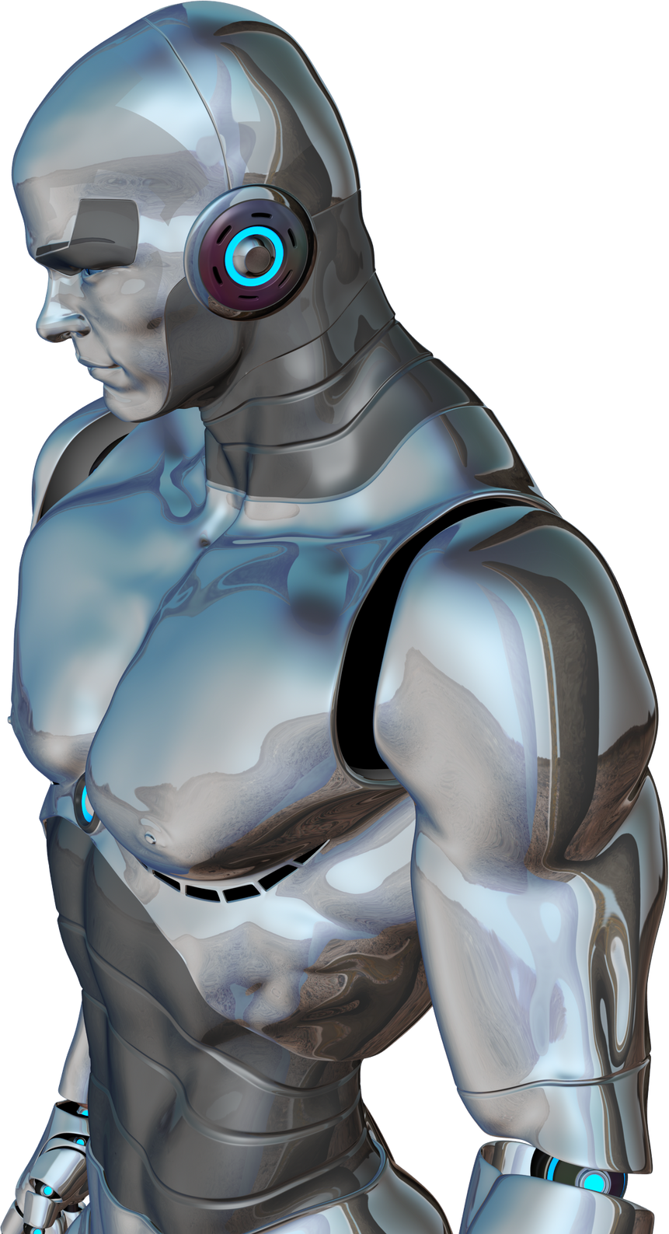
INTERPRETABLE OUTPUT
The system's output clearly highlights the detected fracture, providing visual confirmation for the radiologist.
This demonstrates how the DIP pipeline successfully enhances the raw X-ray to produce an easily understandable and clinically useful result.

Slide 8

CONCLUSION
Conclusion
We successfully developed an automated system for bone fracture detection by fusing Digital Image Processingwith a lightweight CNN.
The structured pipeline enhances fracture visibility, improves localization, and ensures high diagnostic accuracy (~90%).
Crucially, our approach provides interpretable intermediate outputs, allowing clinicians to understand and trust the system's decision-making process.
This work validates that combining traditional DIP with modern AI yields efficient, accurate, and explainable medical diagnostic tools.

Slide 9

FUTURE WORK
Advanced Architectures: Explore more sophisticated deep learning models (e.g., attention-based networks) for even higher accuracy.
3D Reconstruction: Investigate techniques to reconstruct 3D models from 2D X-rays for superior spatial localization of fractures.
Clinical Integration: Develop a real-time system that can be seamlessly integrated into existing hospital and clinical workflows to assist orthopedic specialists.

Slide 10
THANK YOU!

